Slide 1
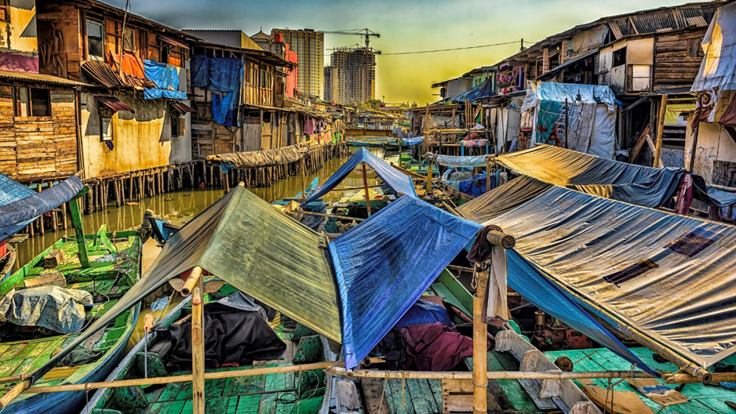
Ending Poverty
By Abe Loewe

Slide 2
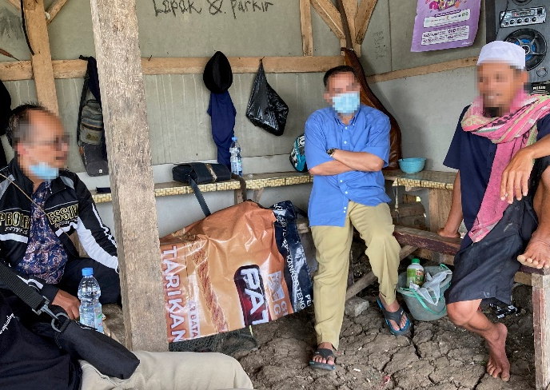
Can poverty be ended?
Are the UN’s Sustainable Development Goals the solution?
Can mankind end poverty or are there deeper problems that mankind cannot solve on their own?

Slide 3
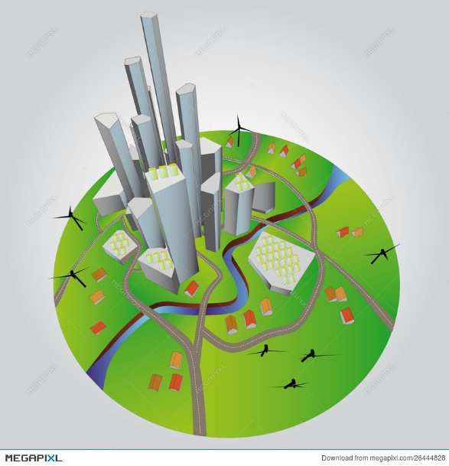
Man’s Solutions
UN SDG’s
Sustainable City

Slide 4
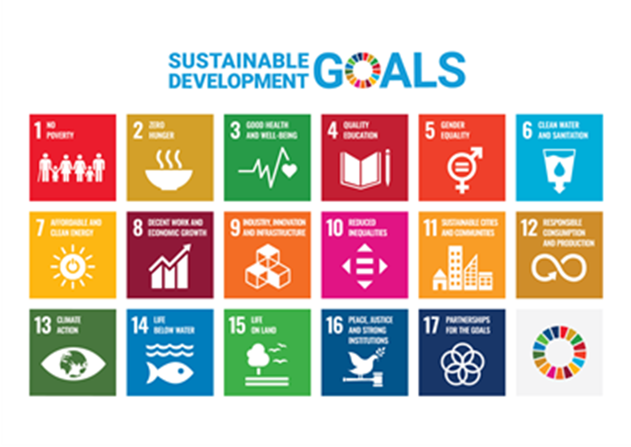
SDGs
The 2030 Agenda for Sustainable Development, adopted by all United Nations Member States in 2015, provides a shared blueprint for peace and prosperity for people and the planet, now and into the future.’

Slide 5
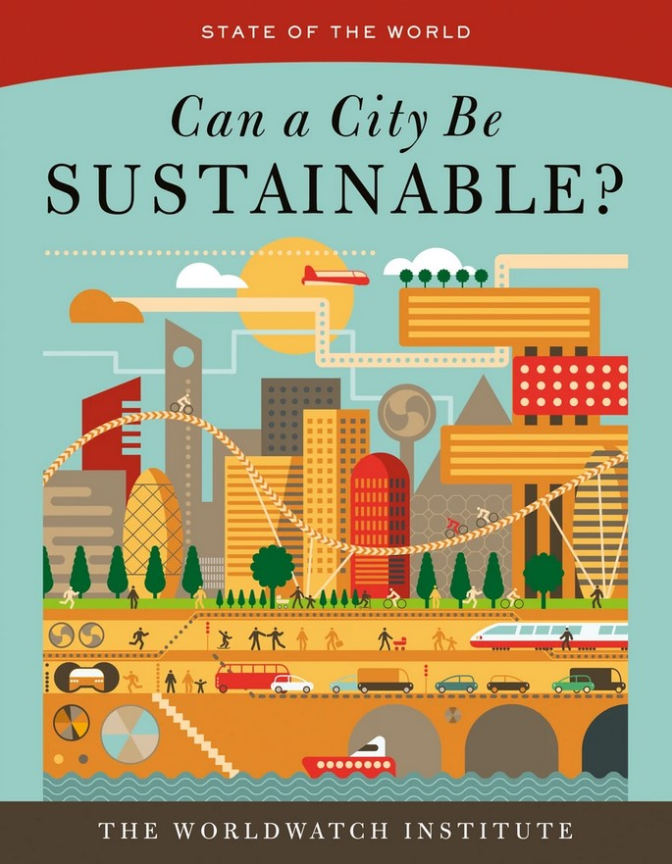
Sustainable City
‘A sustainable city is a vibrant human settlement that provides ample opportunities, in harmony with the natural environment, to create dignified lives for all citizens.’ (Gary Gardner)

Slide 6
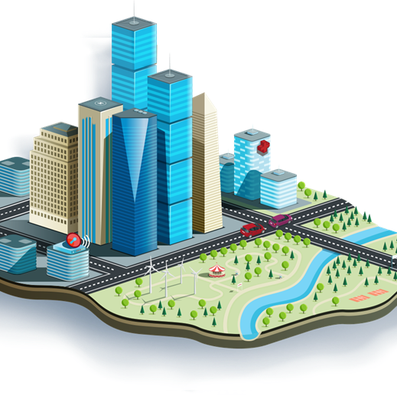
Can Mankind?
Can mankind succeed in ‘ending poverty and maintain peace and prosperity’ as stated in the UN’s SDGs.
The chances of political will overcoming the problem of systemic inequality and exploitation appear slim.’ Gardner suggests that city governments are now the last hope. (Gary Gardner)

Slide 7
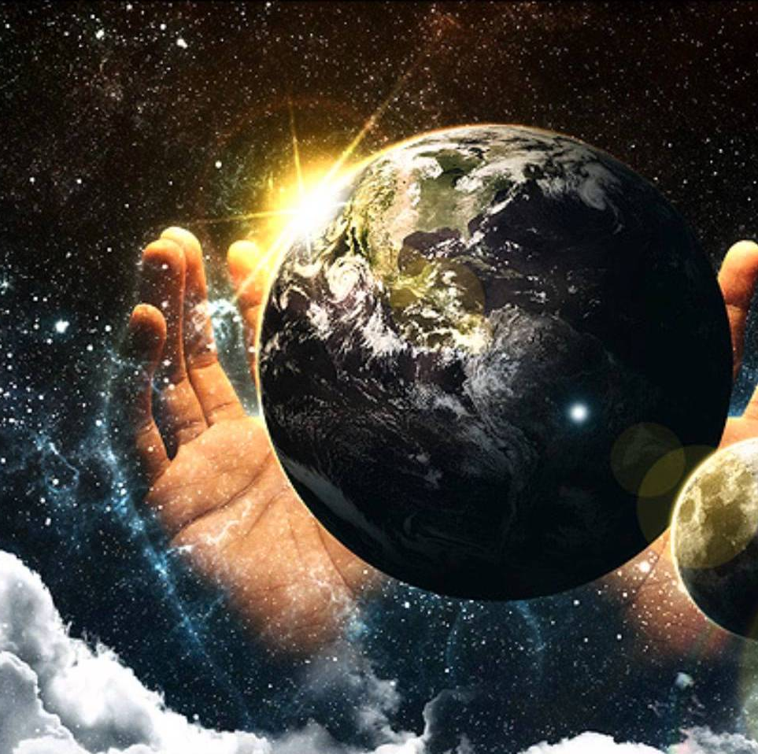
God’s plan
Garden of Eden
Exodus
Jubilee
Revelations

Slide 8
What went wrong?
Hugo Assmann: “We are beginning to realize what we are in history: not merely underdeveloped peoples in the sense of "not yet sufficiently developed," but peoples "kept in a state of underdevelopment": dominated and oppressed peoples-which is a very different thing”.

Slide 9
Current situation
Two-thirds of mankind live under the bread line.
1 Billion illiterate
70% of children suffer from malnutrition
Just to name a few

Slide 10
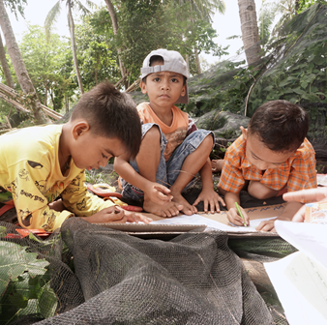
Poverty is caused by
calamity
personal sin
oppression

Slide 11
God’s continued plan
Completed work of Jesus
Holy Spirit in and on believers
Free from sin, sickness, Satan
Manifest Sons

Slide 12
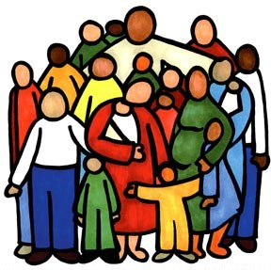
The Body of Christ as the Answer
True disciples will aid the widows and orphans, welcome the stranger and the refugee, and help the destitute.
Membership in God’s kingdom brings love that releases guilt, heals bitterness, and breaks the power of drunkenness, immorality, and gambling.
Disciples defend the oppressed poor by bringing justice. (Grigg)

Slide 13
Conclusion
Although man’s plans are impressive the corruptibleness of man’s heart undermines his own brilliant ideals.
Discipleship
Let us make a lasting change by following in the footsteps of the early church who had no needy persons among themselves.

